Slide 1
System of Linear Equation
Suman Paudel
33
Mathematics for Data Science

Slide 2
$a_{1}x_{1}+a_{2}x_{2}+…+a_{n}x_{n}=b$ (1)
What is Linear Equation ?
A linear equations in the variables $x_{1}, …,x_{n}$ is an equation that can be written in the form:
where b and the coefficients $a_{1},a_{2},…,a_{n}$ are real or complex numbers.

Slide 3
$4x_{1}+5x_{2}+2=x_{1}$ and $x_{2}=2(\sqrt{6}−x_{1}+x_{3}$
Some examples of linear equations: The equation:
are both linear because the can be rearrange algebraically as in equation (1)
$3x_{1}+5x_{2}=−2$ and 2$x_{1}+x_{2}−x_{3}=2\sqrt{6}$
The equation:
$4x_{1}+5x_{2}+2=x_{1}x_{2 }$and $x_{2}=2\sqrt{x_{1}}−6$
are not linear because of the presence of $x_{1}x_{2 }$ in the first equation and $\sqrt{x_{1}}$ in the second.

Slide 4
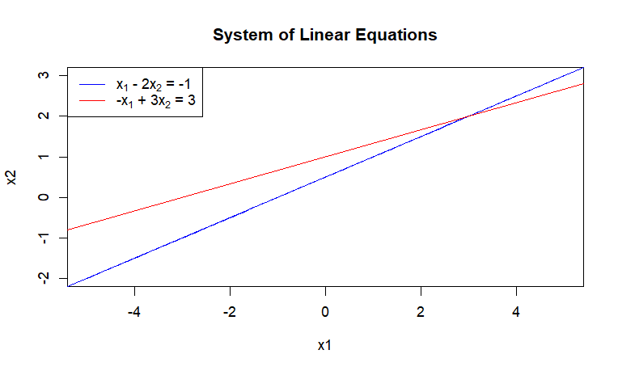
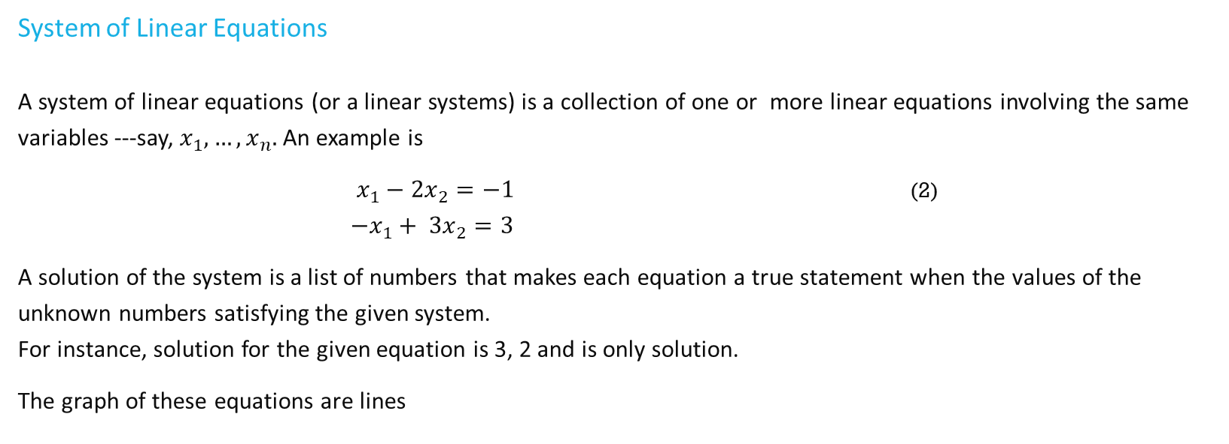
System of Linear Equations A system of linear equations (or a linear systems) is a collection of one or more linear equations involving the same variables ---say, $x_{1}, …,x_{n}.$ An example is
$x_{1}−{2x}_{2}=−1$ (2) ${−x}_{1}+ {3x}_{2}=3$
A solution of the system is a list of numbers that makes each equation a true statement when the values of the unknown numbers satisfying the given system. For instance, solution for the given equation is 3, 2 and is only solution.
The graph of these equations are lines
Fig: Graph of system of linear equation using R

Slide 5
A system of linear equations has either:
no solution, or
exactly, one solution, or
infinitely many solutions.
A system of linear equations is said to be consistent if it has either one solution or infinitely many solutions; a system is inconsistent if it has no solution.

Slide 6
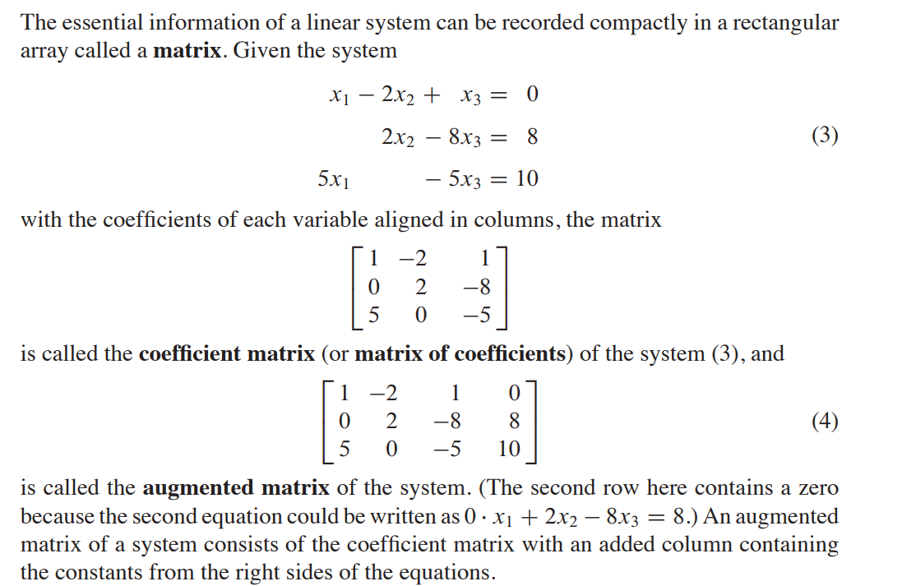
Matrix Notation

Slide 7
Solving a Linear Equation
The basic strategy is to replace one system with an equivalent system (i.e., one with the same solution set) that is easier to solve.
There are three basic operations are used to simplify a linear system.
Replace one equation by the sum of itself and a multiple of another equation,
Interchange two equations,
And multiply all the terms in an equation by a nonzero constant.

Slide 8
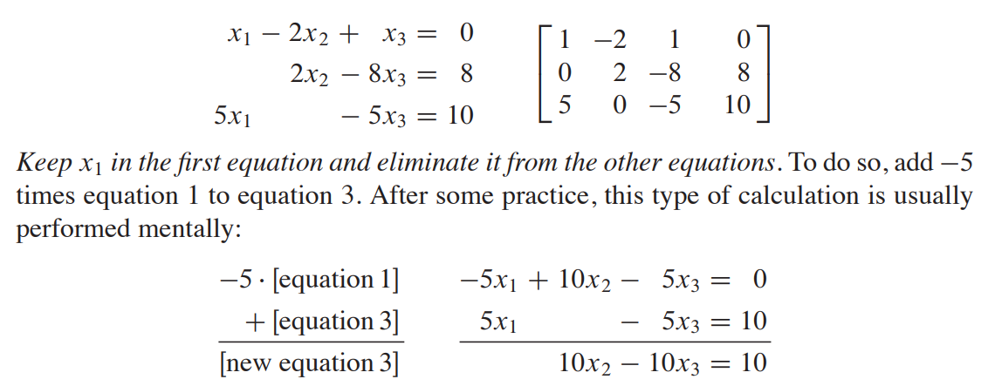
Example: Solving the previous equation 3 (Elimination Method)

Slide 9
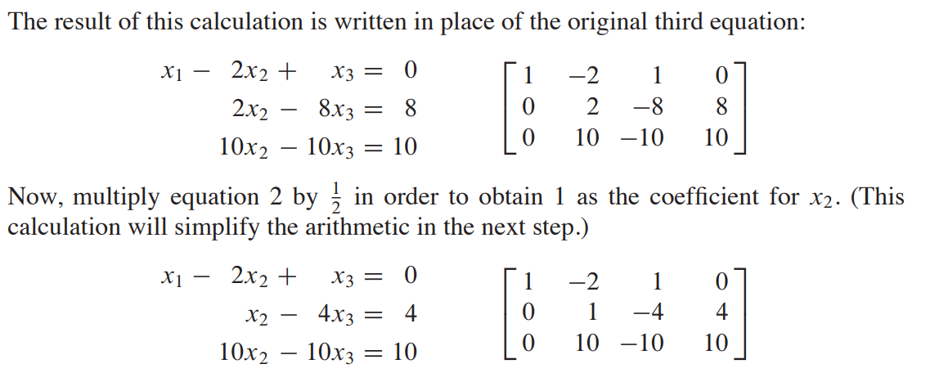
Example: Solving the previous equation 3

Slide 10
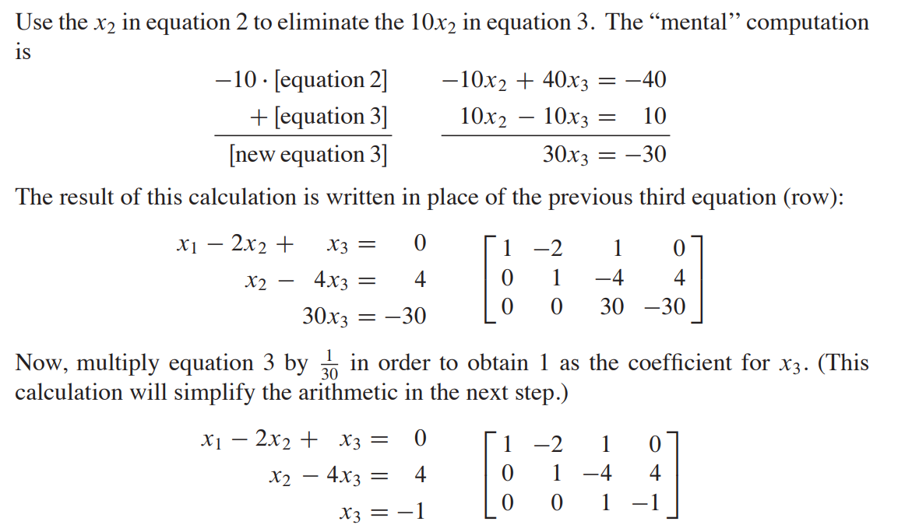
Example: Solving the previous equation 3

Slide 11
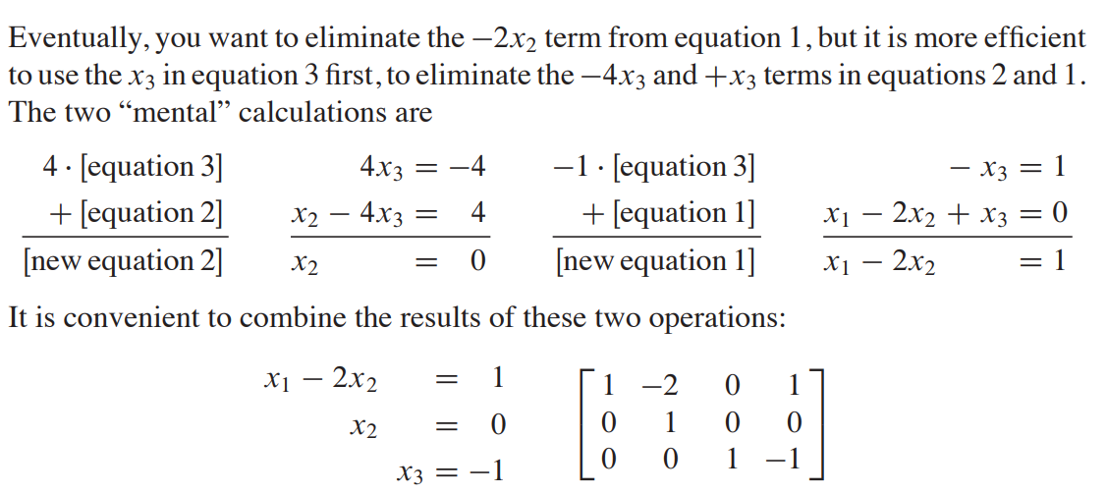
Example: Solving the previous equation 3

Slide 12
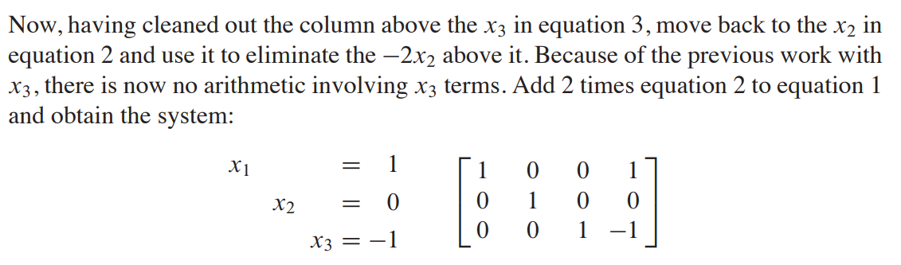
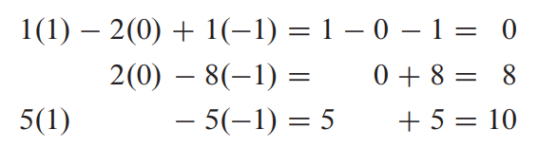
Example: Solving the previous equation 3
It shows that the only solution of the original system is (1, 0, -1). To verify that (1, 0, -1) is a solution, substitute these values into the left side of the original system,
The results agrees with the right side of the original equation, so (1, 0 , -1) is a solution of the system.

Slide 13
Thank You

